Slide 1

WITH CSM (R) MARK GERECHT

Slide 2
TOP’s 15
Frequently Asked Questions
Part of the AskTOP Leadership Series

Slide 3
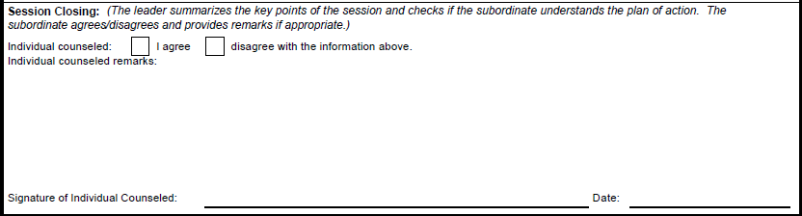

What is the meaning of “disagree” on a 4856 counseling form?
Reflects both sides of the story
No regulatory or Field Manual definition
Myths about Disagreement:
  Agreement
  What was discussed
  NCOER Signature
Refusing to Sign: Soldier/Leader
Notes:
The rated NCO’s signature verifies the following: They seen the completed report, the administrative data (Part I) is correct (except Part Ik through o), the rating officials are proper (Part II), the duty description is accurate (Part III) and includes the counseling dates, the APFT and height/weight entries are correct (Part IVc), and that the rated NCO is aware of the appeals process. It is important that rated NCOs and rating officials clearly understand that the rated NCO’s signature does not constitute agreement or disagreement with the evaluations of the rater and/or senior rater. NOTE: If the rated Soldier is unavailable, unable, or fails to sign the DA Form 2166-8 for any reason, the senior rater will either resolve the problem or explain why in DA Form 2166-8, Part Ve and the rated Soldier’s signature is left blank. The report will not be delayed because it lacks the rated Soldier’s signature.

Slide 4
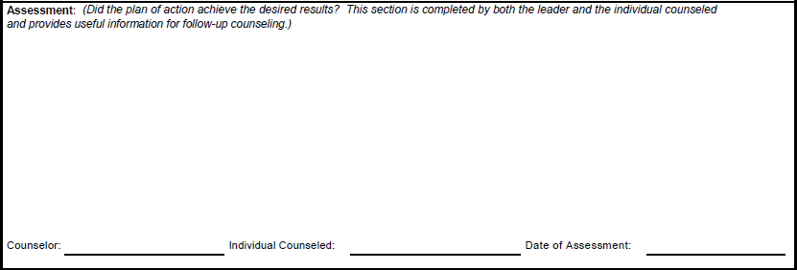
What is the importance of counseling assessments?
  PFC Doe you completed your corrective training to standard and I was impressed with the professionalism you displayed presenting your class and ensuring the team was properly trained in PMCS
  PFC Doe you failed to properly complete the task to standard and I am directing personal corrective training with me on Saturday 11 June. See counseling statement dated: 11 June 2011.
  PFC Doe while you completed your class to standard I was not happy with your attitude and I am recommending punishment under the UCMJ for the poor attitude you displayed in writing your rebuttal.
  See counseling dated 11 June 2011 for assessment completion.
FM 6.22 Figure B-20
Assessment must be filled to complete Event Oriented counseling
Assessments are the most neglected part of counseling sessions and are usually never completed
Notes:
FM 6.22 Figure B-20

Slide 5
Should I refuse to sign counseling statements I disagree with?
Notes:
Option 1: You could refuse to sign. This does not usu­ally help the sit­u­a­tion and can ulti­mately put you at a sig­nif­i­cant dis­ad­van­tage. If you hap­pen to be work­ing for an uneth­i­cal leader, you empower them by not sign­ing. The leader can sim­ply write “Soldier refused to sign” and sign/date the form him­self. At any later date the leader could write a coun­sel­ing state­ment with­out your knowl­edge, and sim­ply write “Soldier refused to sign.” You’ve set a prece­dent at that point. If you try to con­test the counseling, the leader can say, “He always refuses to sign his coun­sel­ing state­ments.” It then becomes your respon­si­bil­ity to prove the coun­sel­ings did or did not take place. You are now on the defen­sive. The odds of this hap­pen­ing are slim but why put your­self in this position?
Option 2 (Recommended): Disagree with the coun­sel­ing and write a rebut­tal. If you need time to write your rebut­tal you can request a rea­son­able period of time to respond to the coun­sel­ing statement. Write “I request 24 hours to prop­erly pre­pare my response to this counseling”.
If the leader refuses to allow you a rea­son­able time period to respond, write “I requested 24 hours to pre­pare my rebut­tal to this coun­sel­ing and SGT Doe refused to allow me ade­quate time to pre­pare my response.”
If he does allow you time to pre­pare your response, write “Please see attached sheet.”
Note: Refusing to sign a coun­sel­ing state­ment shows a lack of matu­rity and pro­fes­sion­al­ism on your part. It sim­ply sets you up for fail­ure. The best course of action is to dis­agree with the coun­sel­ing and write your rebut­tal. Make sure you get a copy of the coun­sel­ing state­ment. You are enti­tled to a copy.

Slide 6
What do I do when a Soldier refuses to sign a counseling statement?
Notes:
Option 1: Write the phrase “Soldier refused to sign” in the clos­ing sec­tion of the form. Date and ini­tial the note.
Option 2: Ask an NCO of equal or higher rank to join the coun­sel­ing session. Ask the Soldier to sign the form in front of the NCO. If the Soldier refuses, ask the NCO to enter a brief state­ment in the clos­ing por­tion of the coun­sel­ing as a third-party wit­ness. Have the NCO date and sign the note. Example:
I observed PFC Doe refuse to sign this coun­sel­ing state­ment. –SGT Mike Dough, 1100hours/5 Nov 10.
Either solu­tion works, but the sec­ond option gives you the added cred­i­bil­ity of a third-party wit­ness should the Soldier attempt to deny the valid­ity of the ses­sion at a later date.

Slide 7
Can I be given corrective training and UCMJ punishment for the same offense?
Notes:
This is not dou­ble jeop­ardy. Corrective train­ing is admin­is­tra­tive in nature and not con­sid­ered pun­ish­ment. UCMJ actions are puni­tive in nature

Slide 8
Can my squad leader give me a backdated counseling statement?
Notes:
No, your squad leader can­not do this. An incor­rect date on a coun­sel­ing form could be con­sid­ered a false offi­cial state­ment or pos­si­bly an act of fraud. This may be an inno­cent mis­take made by an inex­pe­ri­enced leader or the act of a leader who lacks integrity. Either way, this coun­sel­ing state­ment will have your name and sig­na­ture on it. You want to make sure it is correct.

Slide 9
What are the time limitations for the completion of counseling?
Notes:
There are no time lim­its asso­ci­ated with when a derogatory coun­sel­ing should be completed.
FM 6.22, Paragraph B-5, page B-1 states: Successful coun­sel­ing for spe­cific per­for­mance occurs as close to the event as possible.

Slide 10
What gives me the authority to use Physical Fitness as CT?
AR 600-20 para 4-6
  Directly related
  Oriented to improve
  Can be after hours
  Only until deficiency is overcome
  Satisfactory completion will not be noted in official records
AR 600-20 para 4-20
  When authorized by the chain of command
  not unnecessarily cruel, abusive, oppressive or harmful, the following do not constitute hazing
  Administrative corrective measures including a reasonable number of repetitions of authorized physical exercises.
Notes:
AR 600-20 4–6. Exercising military authority
AR 600-20 4–20. Hazing

Slide 11
What gives me the authority to use Physical Fitness as CT? (cont)
TC 3.22-20 para 5-15
  As CT it is often used incorrectly resulting in overtraining or overuse injuries
  No smoke sessions
  Rower, Squat Bender, Windmill, Prone Row, Pushup, V-up, Leg Tuck and Twist, Supine Bike, Swimmer, 8 Ct Pushups
  Only one of the above exercises may be selected for each corrective action
  The number should not exceed 5 reps
Notes:
TC 3.22-20

Slide 12
What are some examples of inappropriate Corrective Training
Cutting grass with scissors and a ruler
Cutting grass at night with a flashlight
Cleaning an area with a toothbrush
Wearing a sign that states offense
Use Common Sense… Treat Soldiers the way you want to be treated!

Slide 13
What privileges can be revoked?
Pass
Civilian Clothing
Personal Property
Driving Privileges
PX
Commissary
Alcohol
MWR
Off Post Living
Visitation
Tobacco
Weapons
Off Duty Employment
Unit Sports

Slide 14
Can a Soldier be recommended/approved for awards while flagged for APFT failure?
Notes:
AR 600–8-22 does not pro­hibit awards to be approved or pre­sented to Soldiers who are flagged for fail­ing the APFT.
AR 600–8-22 refers to AR 600–8-2, par 1–12, which states that a “flag pro­hibits cer­tain per­son­nel actions” to include awards and dec­o­ra­tions.
Then to par 1-15a, AR 600–8-2, which states that “flags for APFT fail­ure block pro­mo­tion, reen­list­ment, and exten­sion only.”
AR 600–8-2 autho­rizes an excep­tion for Soldiers to receive awards and dec­o­ra­tions while flagged for fail­ing the APFT.

Slide 15
Can my rater falsify counseling dates on my NCOER?
Notes:
It is not appro­pri­ate to place infor­ma­tion on offi­cial doc­u­ments that is not fac­tual. It is wrong to place coun­sel­ing dates on an NCOER if these dates did not occur as indi­cated on the eval­u­a­tion report.
If the per­for­mance coun­sel­ing ses­sions did not occur, the rater should remove the fal­si­fied dates. The senior rater then makes a com­ment as to why the coun­sel­ing was not con­ducted IAW AR 623–3.
Your sig­na­ture on the NCOER means that you agree the dates of coun­sel­ing are cor­rect among other things. For an in-depth expla­na­tion see: What does my sig­na­ture mean on the NCOER? or con­sult AR 623–3.
See Can my squad leader give me a back­dated coun­sel­ing state­ment? for addi­tional infor­ma­tion about back­dated coun­sel­ing statements.

Slide 16
Can I administer a “for record” APFT while deployed?
Notes:
For a PT test to count as a record PT test the Commander must spec­ify before­hand if the test is for record. It does not mat­ter if you are in a deployed or gar­ri­son envi­ron­ment.
AR 350–1, page:12, para: 1-24e(2):
Commanders may admin­is­ter the APFT as often as they wish; how­ever, they must spec­ify before­hand when the results are for record. The AA and Active Guard/Reserve (AGR) Soldiers will take the APFT at least twice each cal­en­dar year. A min­i­mum of 4 months will sep­a­rate record tests if only two record tests are given. The intent is for the Active Army and the AGR Soldiers to take a record APFT every 6 months. Mission require­ments often pre­vent the even spac­ing of record tests. Therefore, com­man­ders are encour­aged to test Soldiers for record as close to the record test win­dow as possible.

Slide 17
Can a Solider decline to do push-ups for Corrective Training?
Notes:
Short answer is: No, the Soldier can­not decline.
More infor­ma­tion on cor­rec­tive train­ing:Using Corrective Training to moti­vate sub­stan­dard performers

Slide 18
Q&A

Slide 19
Thank you
More questions? Additional information can be found on our website: AskTOP.net

